Slide 1
NeuraLingo: A Multilingual Chat Application
Submitted in the partial fulfillment for the award of the degree of
BACHELOR OF ENGINEERING
IN
COMPUTER SCIENCE ENGINEERING
Submitted by:
APRATIM SADHU 19BCS6041
SAWAN SIHAG 19BCS6059
ARSHIYA SARMAI 19BCS6060
NEEL MADHAB ROY 19BCS6064
ANMOL CHOPRA 19BCS6069
Under the Supervision of:
DR. MONIKA SINGH
Department of AIT-CSE
DISCOVER . LEARN . EMPOWER

Slide 2
Outline
Introduction to Project
Problem Formulation
Objectives of the work
Methodology used
Results and Outputs
Conclusion
Future Scope
References

Slide 3
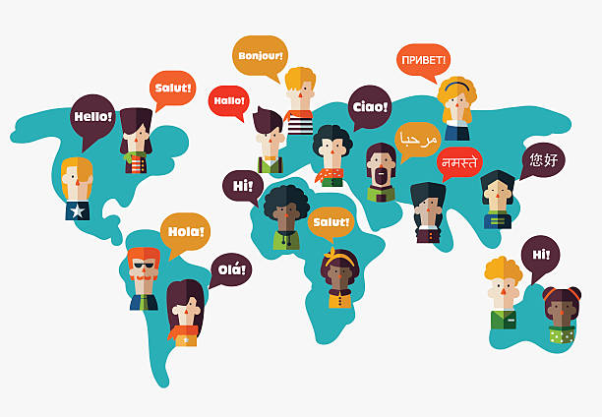
Introduction
This application will support 5
most commonly spoken language around
the world.
The focus of Translr is to integrate the functionalities of a language translator along with a chat application to help peers-to-peers communication in their language of their choice, into a single android based application easily available to the users.
This project is an application of neural machine translation which will be implemented to translate 5 commonly spoken languages.

Slide 4
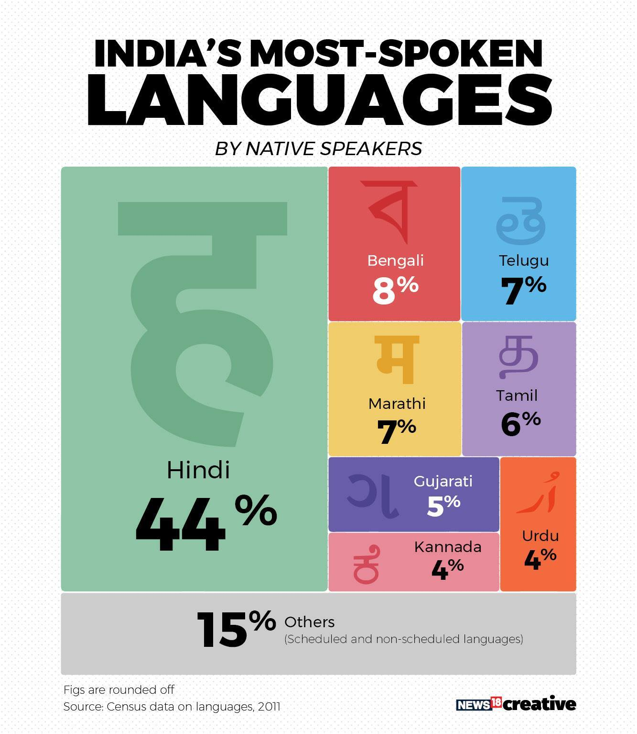
Problem Statement
Communication is fundamental to the existence and survival of individuals, groups, societies and nations, And to do that language is the most common tool of communication Translation of language plays an important role in minimizing the communication gap between different people. A messaging application that translates texts can eradicate the linguistic gap of people around the world.

Slide 5
Objectives
The project aims at accurate and effective translation of English to 5 most commonly spoken languages: German, Spanish, French, Hindi and Bengali.
Develop attentional encoder decoder with LSTM and Transformer networks
A detailed comparison of the translation models using different metrics.
Develop an android messaging application for peer-to-peer communication in their own language.
Make communication easy for people with different linguistic background.

Slide 6
Methodology used
A detailed study and analysis of the datasets (English, German, French, Spanish, Hindi, Bengali) has been carried out in order to make the neural translation model.
NLP preprocessing will be done on datasets, such as tokenization and vectorization will be done prior to modeling.
An encoder-decoder with LSTM network will be implemented using Keras API along with transformer network with multi-head attention.
The model for different language translation will be evaluated using BLEU score and WER score.
On achieving the desired results, the model will be used for deployment using Django API Framework.
An android chat application will be developed to used the models for communication in respective languages.

Slide 7
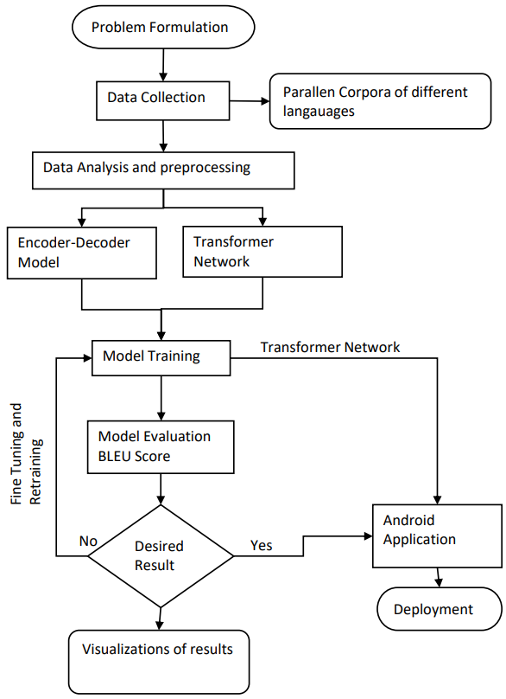
Flowchart

Slide 8
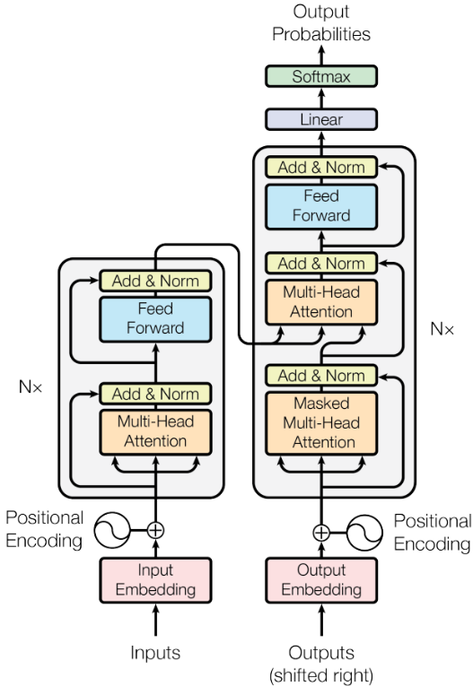
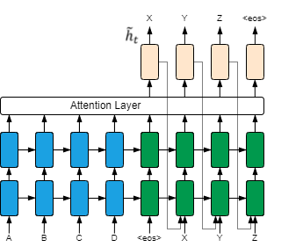
Attentional Encoder-Decoder Network
Transformer Network

Slide 9
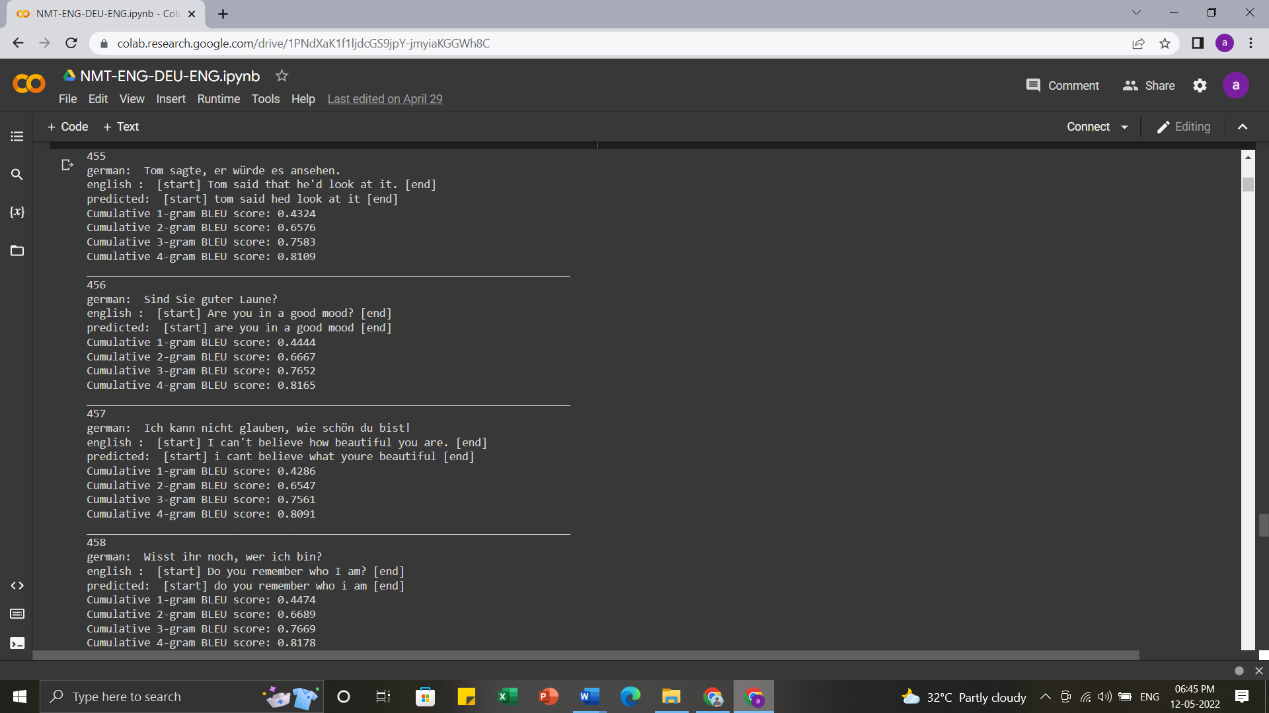
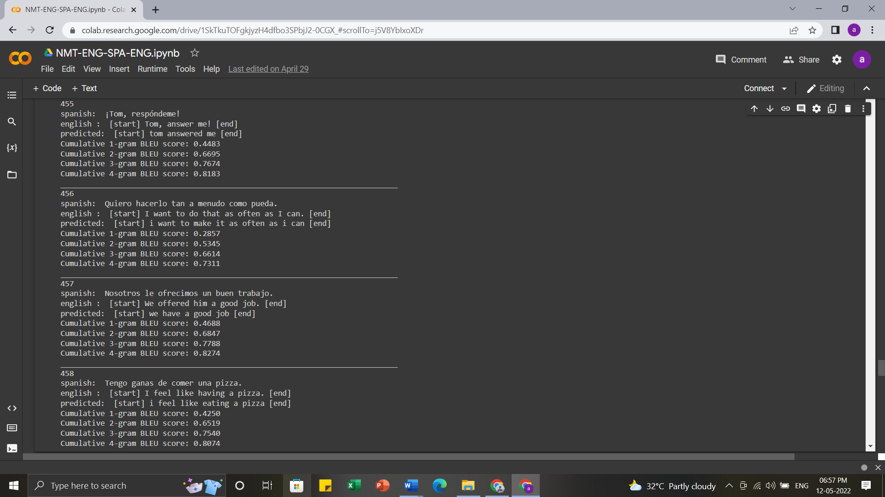
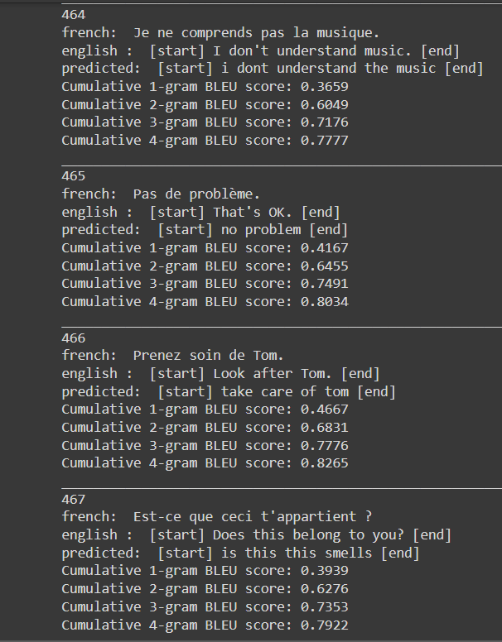
Some sample Translations
German
Spanish
French

Slide 10
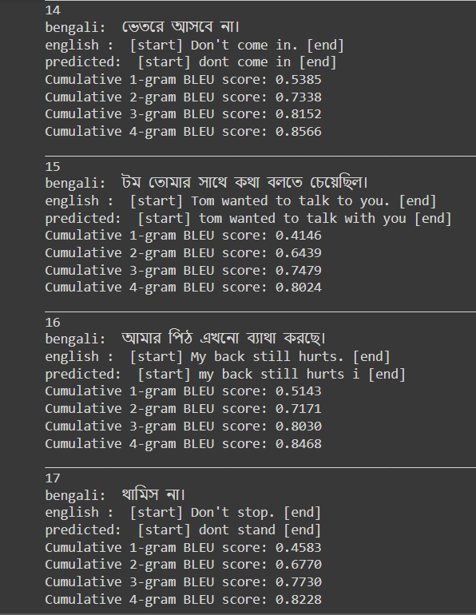
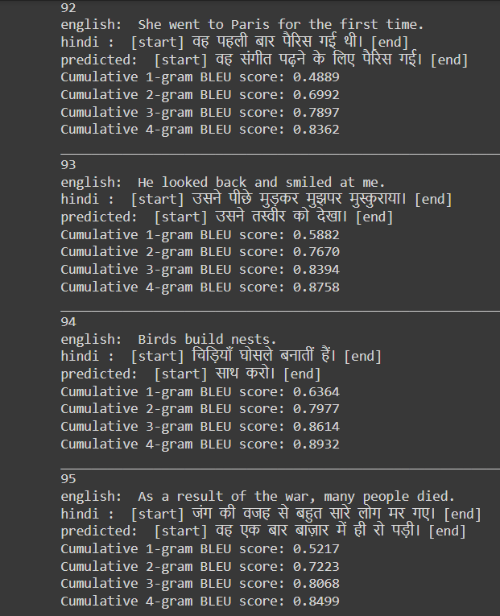
Bengali
Hindi

Slide 11
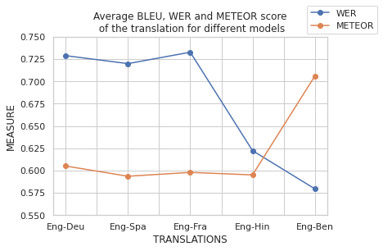
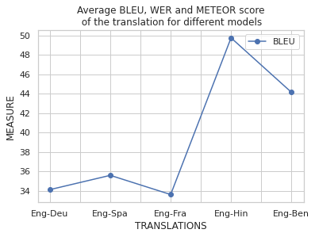
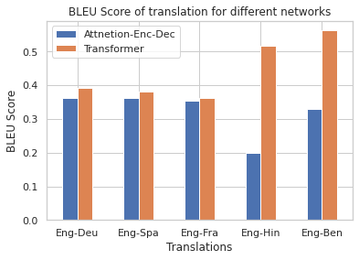
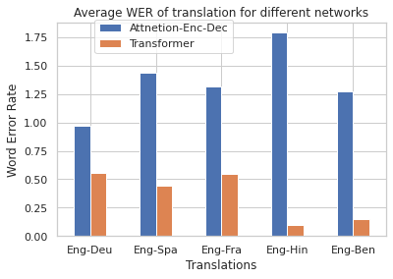
BELU, WER and METEOR score of Transformer model trained for 100 epochs using 3K samples
BELU, WER and METEOR score of Transformer and encoder decoder model different training size

Slide 12
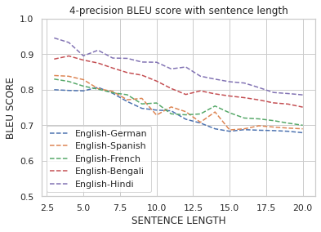
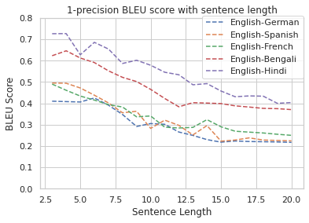
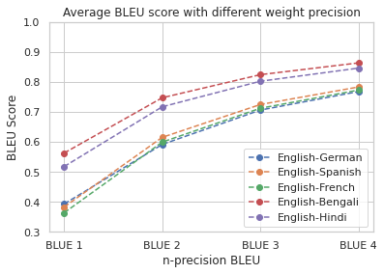

Slide 13
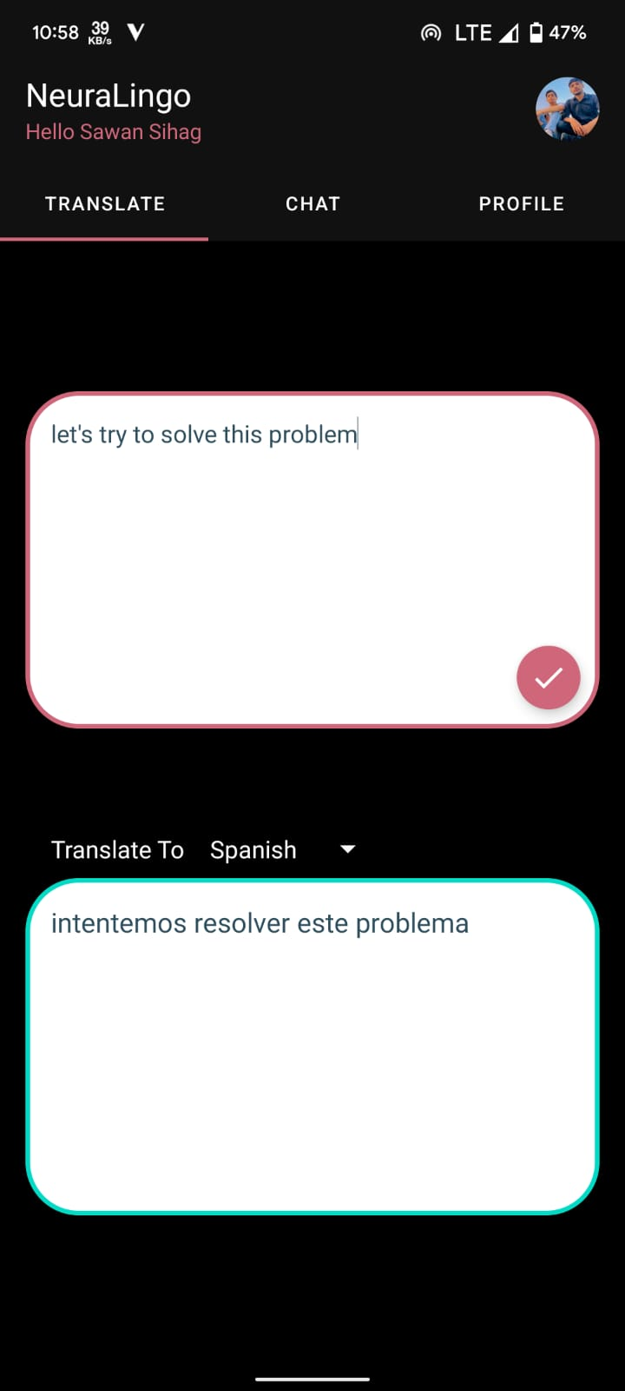
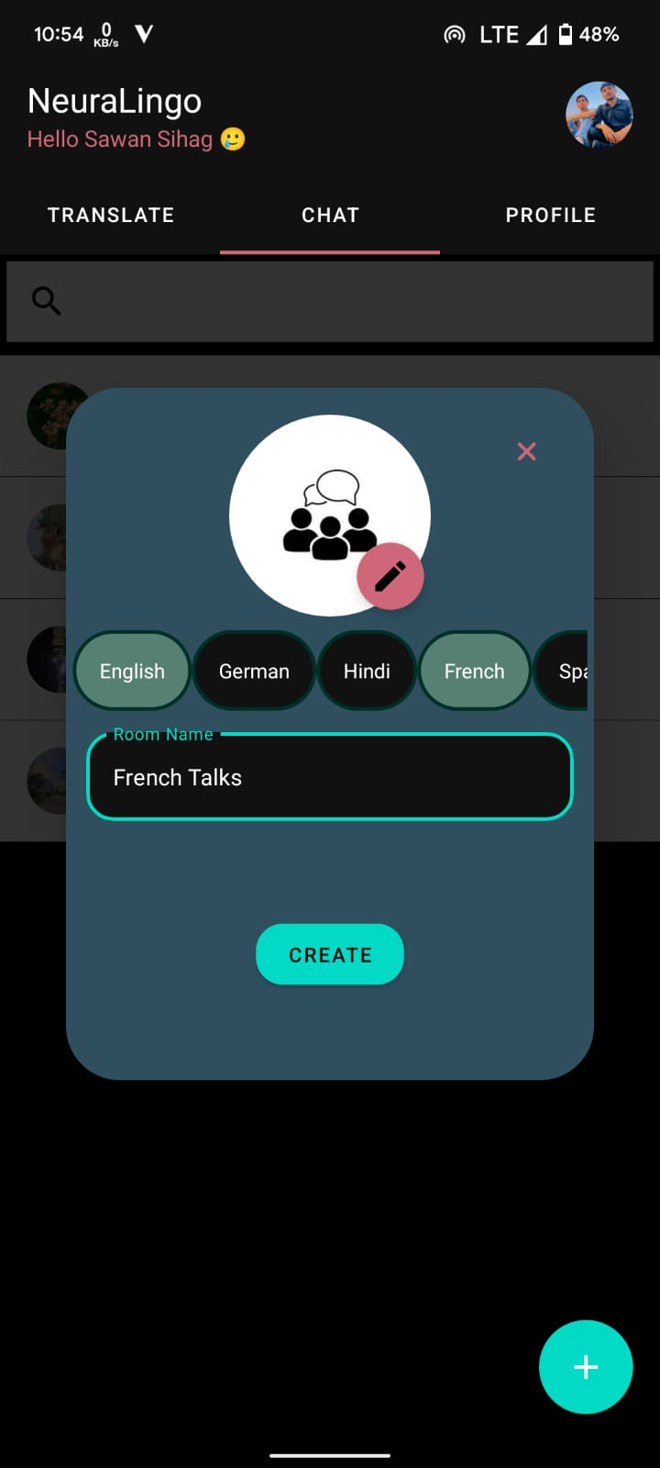
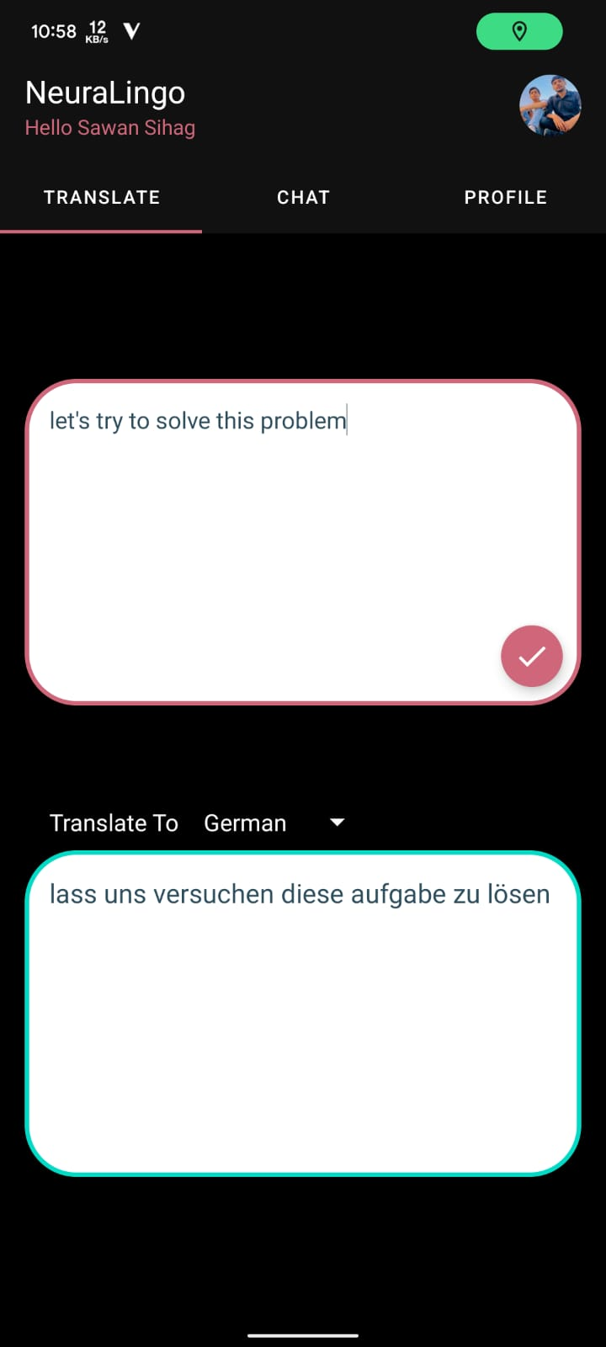

Slide 14
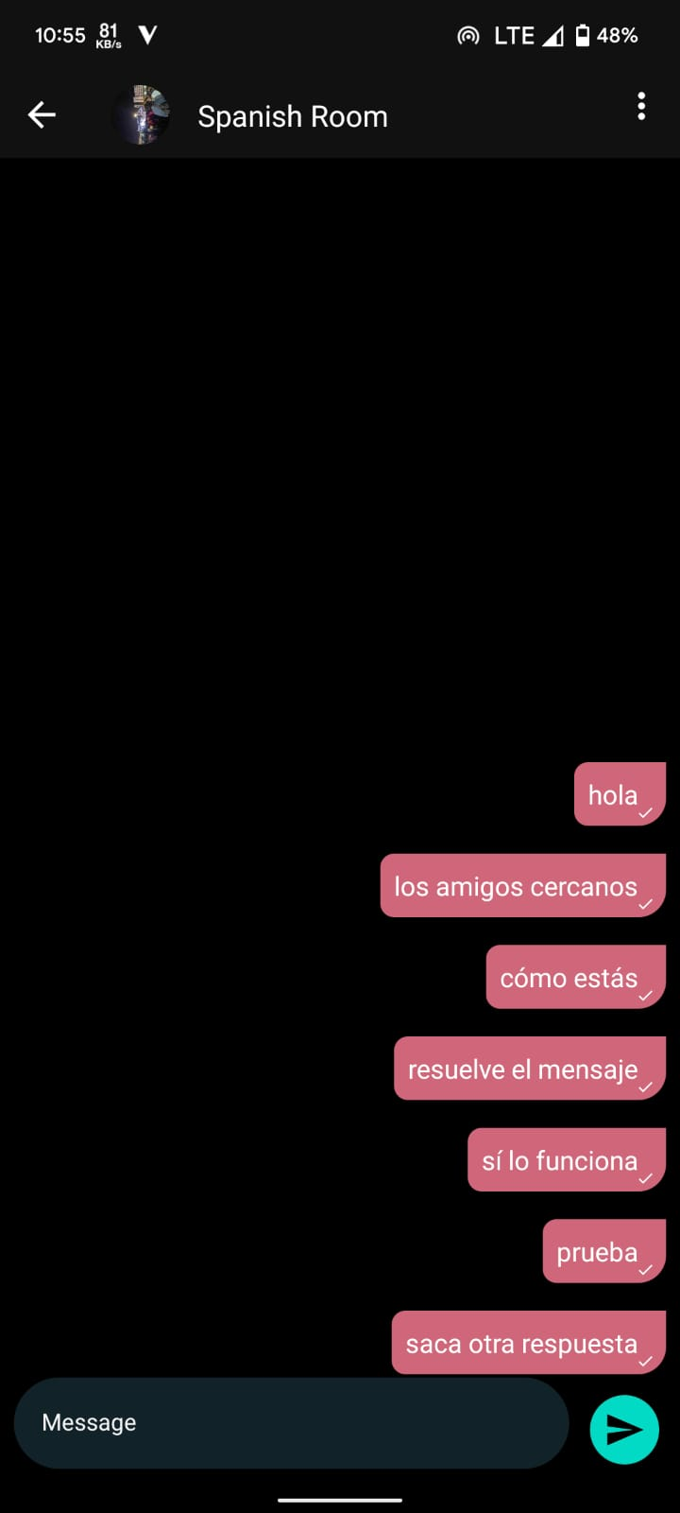
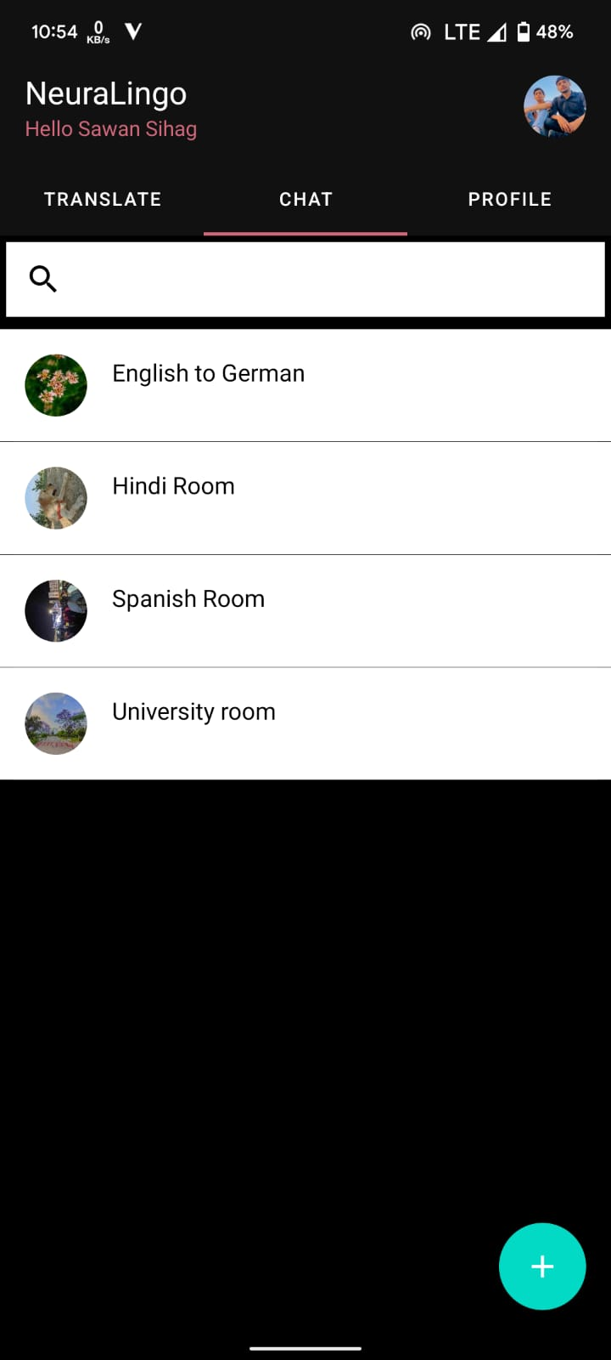
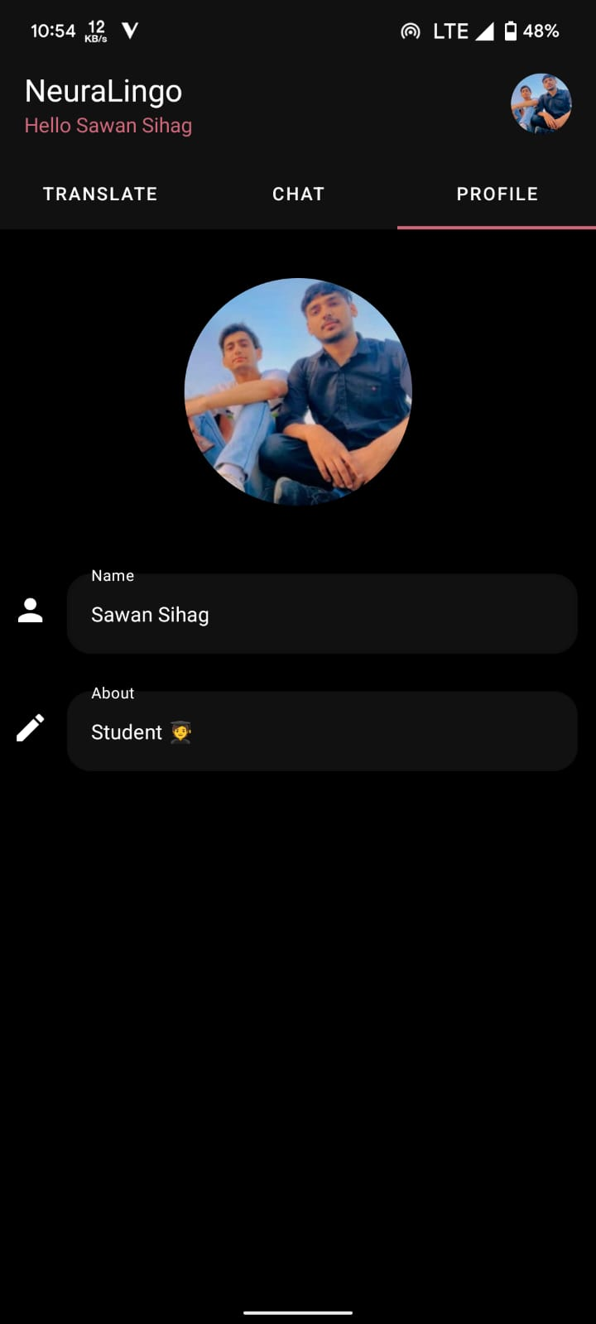

Slide 15
Results and Conclusion
The translation performance of the models for different languages will be good enough to be used in a chat application for effective communication.
A research paper based on the findings after implementation of the models and their evaluation.
The end result of this project is an android chat application.

Slide 16
Future Scope
The android chat application can be used by people around the world once it is deployed.
More languages can be added to the application.
The results of the neural machine translation models can be used in the future for comparison and analysis.
The performance of the models can be improved by training for longer period of time.

Slide 17
References
https://www.manythings.org/bilingual/
https://github.com/fchollet/keras
https://keras.io/examples/nlp
https://lena-voita.github.io/nlp_course/seq2seq_and_attention.html
https://towardsdatascience.com/foundations-of-nlp-explained-bleu-score-and-wer-metrics-1a5ba06d812b
https://bayesianquest.com/2020/10/24/viii-build-and-deploy-data-science-products-machine-translation-application-build-and-deploy-using-flask/
https://jalammar.github.io/illustrated-transformer/
https://galhever.medium.com/neural-machine-translation-with-transformers-69d4bf918299

Slide 18

Any Queries?

